Slide 1
Applied Probability I Topic 5 – Continuous Random Variables
Dr. Bahman Honari
Fall 2020

Slide 2
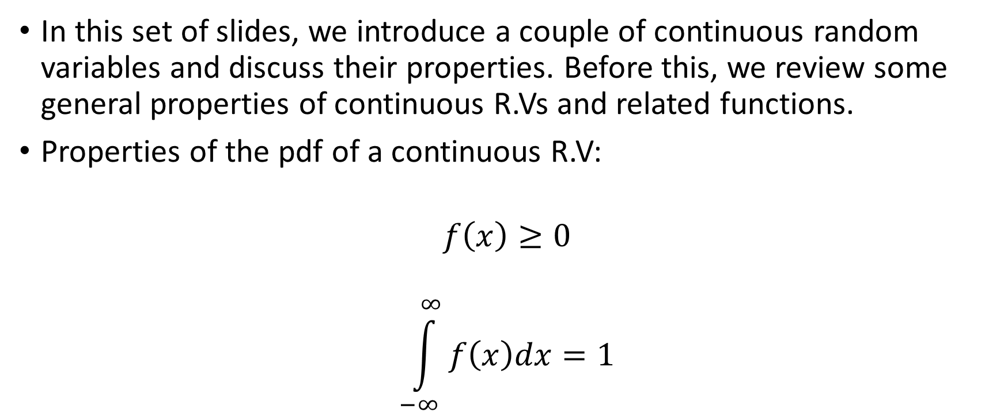
Continuous Random Variables
In this set of slides, we introduce a couple of continuous random variables and discuss their properties. Before this, we review some general properties of continuous R.Vs and related functions.
Properties of the pdf of a continuous R.V:
$$f\left(x\right)≥0$$
$$\int_{−∞}^{∞}{f\left(x\right)dx=1}$$

Slide 3

Continuous Random Variables cont.
$$F\left(a\right)=P(X≤a)=\int_{−∞}^{a}{f\left(x\right)dx}$$
$$f\left(x\right)= \frac{dF(x)}{dx}$$
$$P\left(α<X<β\right)=\int_{α}^{β}{f\left(x\right)dx}=F\left(β\right)−F(α)$$
$$P\left(X=α\right)=\lim_{ε →0}{\int_{α−ε}^{α+ε}{f\left(x\right)dx}}=\lim_{ε →0} \left[F\left(α+ε\right)−F(α−ε) \right]=0$$

Slide 4

1- Uniform Distribution
$$f\left(x\right)=k a≤x≤b$$
$$\int_{−∞}^{∞}{f\left(x\right)dx=\int_{a}^{b}{kdx=k\left(b−a\right)=1 }→ k=\frac{1}{b−a} }$$
$$f\left(x\right)=\frac{1}{b−a} a≤x≤b$$
$$E\left[X\right]=\int_{a}^{b}{x \frac{1}{b−a}dx}=\frac{a+b}{2} , Var\left[X\right]=E\left[X^{2}\right]−E^{2}\left[X\right]=\frac{{\left(b−a\right)}^{2}}{12}$$
$$m_{X}\left(t\right)=E\left[e^{tX}\right]=\int_{a}^{b}{e^{tx} \frac{1}{b−a}dx}=\frac{e^{tb}−e^{ta}}{b−a}$$
$$P\left(α<X<β\right)=\int_{α}^{β}{\frac{1}{b−a}dx}=\frac{β −α}{b−a} \left(a<α<β<b\right)$$

Slide 5

2- Exponential Distribution
$$f\left(x\right)=λe^{−λx} x≥0$$
$$E\left[X\right]=\frac{1}{λ} , Var\left[X\right]=\frac{1}{λ^{2}}$$
$$m_{X}\left(t\right)=E\left[e^{tX}\right]=\frac{λ}{λ−t} t<λ$$
The Exponential distribution is used to model the lifetime of electronic components.

Slide 6
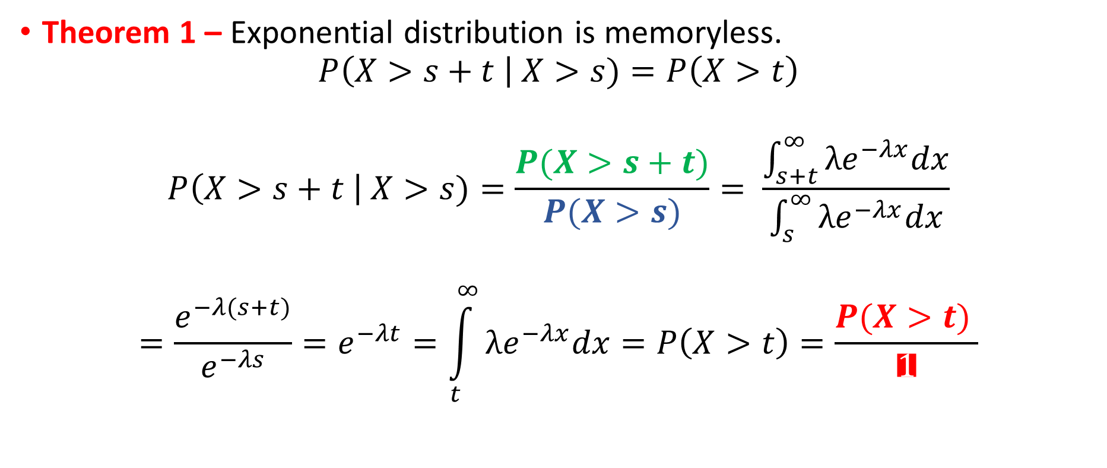
2- Exponential Distribution cont.
Theorem 1 – Exponential distribution is memoryless.
$$P\left(X>s+t \right| X>s)=P\left(X>t\right)$$
$$P\left(X>s+t \right| X>s)=\frac{P(X>s+t)}{P(X>s)}= \frac{\int_{s+t}^{∞}{λe^{−λx}dx}}{\int_{s}^{∞}{λe^{−λx}dx}}$$
$$=\frac{e^{−λ(s+t)}}{e^{−λs}}=e^{−λt}=\int_{t}^{∞}{λe^{−λx}dx}=P\left(X>t\right)=\frac{P(X>t) }{1}$$

Slide 7

























2- Exponential Distribution cont.
$f(x$)
$f(x$)
$$s+t$$
$$x$$
$$x$$
$$t$$
$$s$$
$$=$$
$$t$$
$$s$$
$$s+t$$
$f(x$)
$f(x$)
$$s+t$$
$$x$$
$$x$$
$$t$$
$$s$$
$$t$$
$$s$$
$$s+t$$

Slide 8

2- Exponential Distribution cont.
Theorem 2 – Exponential distribution is the only continuous distribution that is memoryless.
$$P\left(X>s+t \right| X>s)=P\left(X>t\right) → \frac{P(X>s+t)}{P(X>s)}=P\left(X>t\right) → P\left(X>s+t\right)=P\left(X>s\right)P\left(X>t\right)$$
$$\left[1−F(s+t)\right]=\left[1−F(s)\right]\left[1−F(t)\right] → G\left(s+t\right)=G\left(s\right)G\left(t\right) knowing that 0≤G(.)≤1$$
$$s→t → G\left(2t\right)=G^{2}\left(t\right), and similarly G\left(3t\right)=G^{3}\left(t\right), …, G\left(kt\right)=G^{k}\left(t\right) → G\left(t\right)=G^{\frac{1}{k}}\left(kt\right)$$
$$then easily → G\left(\frac{m}{n}t\right)=G^{\frac{m}{n}}\left(t\right) and therefore → G\left(xt\right)=G^{x}\left(t\right)$$
$$Now let t=1 →G\left(x\right)=G^{x}\left(1\right) therefore G\left(x\right)=e^{x lnG(1)}$$
$$1−F\left(x\right)=e^{x lnG\left(1\right)} → F\left(x\right)=1−e^{x lnG\left(1\right)}$$
$$→ f\left(x\right)=−lnG\left(1\right)e^{x lnG\left(1\right) } that is in form of Exponential distribution.$$

Slide 9
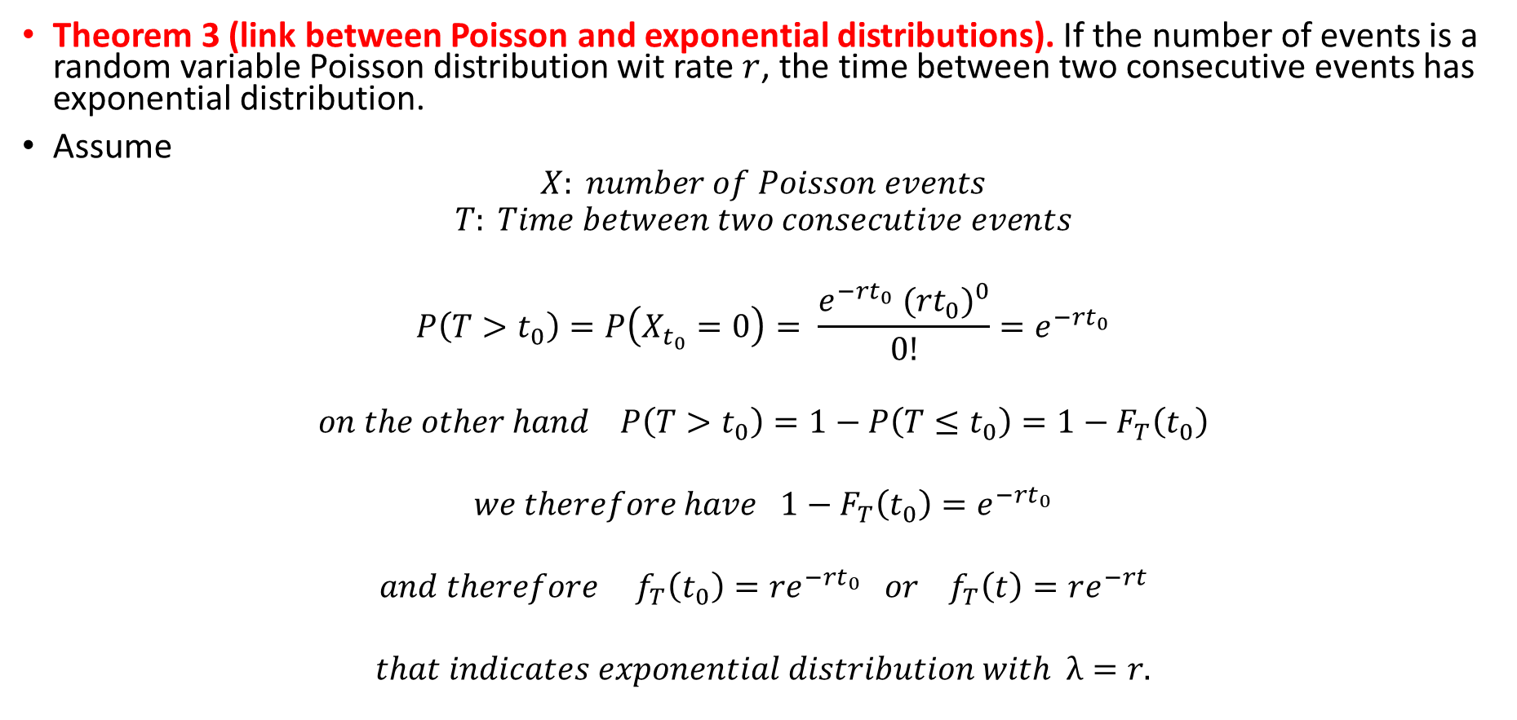
2- Exponential Distribution cont.
Theorem 3 (link between Poisson and exponential distributions). If the number of events is a random variable Poisson distribution wit rate $r$, the time between two consecutive events has exponential distribution.
Assume
$$X: number of Poisson events$$
$$T: Time between two consecutive events$$
$$P\left(T>t_{0}\right)=P\left(X_{t_{0}}=0\right)= \frac{e^{−rt_{0}}{ ({rt}_{0})}^{0}}{0!}{=e}^{−rt_{0}}$$
$$on the other hand P\left(T>t_{0}\right)=1−P\left(T≤t_{0}\right)=1−F_{T}\left(t_{0}\right)$$
$$we therefore have 1−F_{T}\left(t_{0}\right)=e^{−rt_{0}}$$
$$and therefore { f}_{T}\left(t_{0}\right)=re^{−rt_{0}} or{ f}_{T}\left(t\right)=re^{−rt}$$
$$that indicates exponential distribution with λ=r.$$

Slide 10

3- Erlang Distribution
If $X_{1},X_{2},…,X_{n}$ are independent, identical Exponential RVs, then
$$X = X_{1}+X_{2}+…+X_{n}$$
has Erlang distribution with
$$f\left(x\right)={\left(λx\right)}^{n−1}λe^{−λx} x≥0$$
and
$$E\left[X\right]=\frac{n}{λ} , Var\left[X\right]=\frac{n}{λ^{2}}$$
$$m_{X}\left(t\right)=E\left[e^{tX}\right]={\left(\frac{λ}{λ−t}\right)}^{n} t<λ$$

Slide 11

4- Normal Distribution
$$f\left(x\right)= \frac{1}{\sqrt{2π}σ}e^{− \frac{{\left(x−μ\right)}^{2}}{2σ^{2}}} −∞<x<+∞$$
$$E\left[X\right]=μ, Var\left[X\right]=σ^{2} , m_{X}\left(t\right)=e^{μt+ \frac{σ^{2}t^{2}}{2}}$$
$$Z= \frac{X−μ}{σ}$$
$$f\left(z\right)= \frac{1}{\sqrt{2π}}e^{− \frac{z^{2}}{2}} −∞<z<+∞$$
$$E\left[Z\right]=0, Var\left[Z\right]=1$$

Slide 12
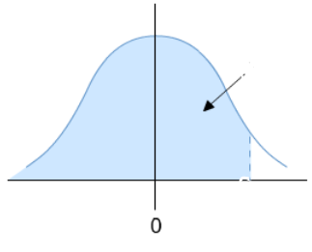



4- Normal Distribution Cont.
$$φ\left(α\right)$$
$$φ\left(α\right)= \int_{−∞}^{α}{\frac{1}{\sqrt{2π}}e^{− \frac{z^{2}}{2}}dz}$$
$$P\left(a<X<b\right)=P\left(\frac{a−μ}{σ}<\frac{X−μ}{σ}<\frac{b−μ}{σ}\right)=P\left(\frac{a−μ}{σ}<Z<\frac{b−μ}{σ}\right)$$
$$=P\left(Z<\frac{b−μ}{σ}\right)−P\left(Z<\frac{a−μ}{σ}\right)= φ\left(\frac{b−μ}{σ}\right)−φ\left(\frac{a−μ}{σ}\right)$$
$$α$$

Slide 13
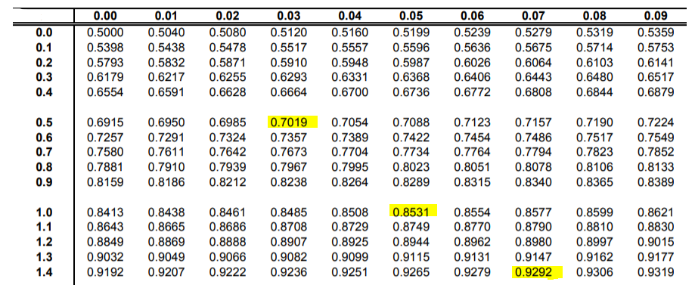

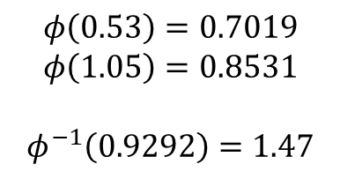


4- Normal Distribution Cont.
$$α$$
$$φ\left(0.53\right)=0.7019$$
$$φ\left(1.05\right)=0.8531$$
$$φ^{−1}\left(0.9292\right)=1.47$$
$$φ\left(α\right)$$
$$α$$

Slide 14
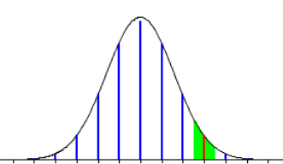





Normal Approximation for Binomial Probabilities
$$P\left(X=x_{0}\right)= \left(\begin{matrix}n \\ x_{0}\end{matrix}\right)p^{x_{0}}q^{{n−x}_{0}}≈φ\left(\frac{x_{0}+\frac{1}{2}−μ}{σ}\right)−φ\left(\frac{x_{0}−\frac{1}{2}−μ}{σ}\right) where we put \left\{\begin{aligned}μ=np \\ σ= \sqrt{npq}\end{aligned}\right.$$
We can show under some assumption as below, Normal distribution can be used to find approximate probabilities for both Binomial and Poisson distributions.
$$X\sim B\left(n,p\right), large n, and small p$$
$$x_{0}$$
$$x_{0}−\frac{1}{2}$$
$$x_{0}+\frac{1}{2}$$

Slide 15

Normal Approximation for Poisson Probabilities
Using a visual illustration similar to the previous slide, we can show
$$X\sim P\left(λ\right) , large λ$$
$$P\left(X=x_{0}\right)= \frac{e^{−λ}λ^{x_{0}}}{x_{0}!}≈φ\left(\frac{x_{0}+\frac{1}{2}−μ}{σ}\right)−φ\left(\frac{x_{0}−\frac{1}{2}−μ}{σ}\right) where we put \left\{\begin{aligned}μ=λ \\ σ= \sqrt{λ}\end{aligned}\right.$$

